Slide 1


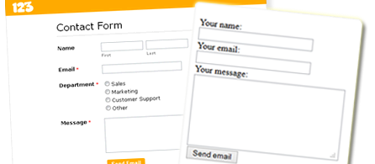

Working with Forms in PHP
HTTP GET / POST, Validation, Escaping, Input Types, Submitting Arrays, URL Redirecting, PHP Superglobals
Svetlin Nakov
Technical Trainer
www.nakov.com
Software University
http://softuni.bg

Slide 2

Table of Contents
HTTP Request Methods
HTML Escaping & Data Validation
Query Strings
Checkboxes
Hidden Fields
Submitting Arrays
Other Input Types
URL Redirecting
Other Superglobals ($_SESSION, $_COOKIE)

Slide 3
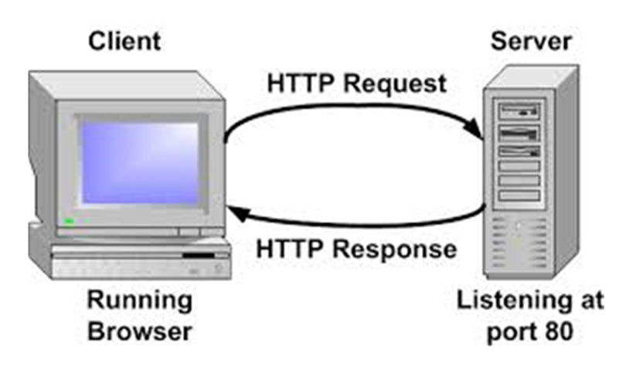
HTTP Request Methods
How Browsers Send Form Data?

Slide 4
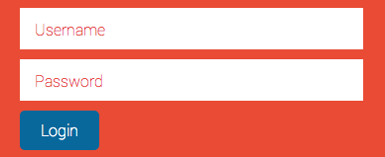
HTTP Request Methods
Forms allow the user to enter data that is sent to a server for processing via HTTP request methods
The most used HTTP request methods: GET and POST
In PHP the posted form data is stored in the $_GET or $_POST associative arrays

Slide 5

GET Request Method
HTTP GET
Retrieves data from the server from given URL
The form data is stored in $_GET associative array
The data sent by GET method can be accessed using $_SERVER['QUERY_STRING'] environment variable
<form method="get" action="index.php">
…
</form>

Slide 6
GET Request Method – Example
<form method="get">
Name: <input type="text" name="name" />
Age: <input type="text" name="age" />
<input type="submit" />
</form>
<?php
// Check the keys "name" or "age" exist
if (isset($_GET["name"]) || isset($_GET["age"])) {
echo "Welcome " . htmlspecialchars($_GET['name']) . ". <br />";
echo "You are " . htmlspecialchars($_GET['age']). " years old.";
}
?>

Slide 7

POST Request Method
The POST method transfers data in the HTTP body
Not appended to the query string
The posted data is stored in $_POST associative array
By using htps:// you can protect your posted data
POST can send text and binary data, e.g. upload files
<form method="post" action="index.php">
…
</form>

Slide 8
POST Request Method – Example
<form method="post">
Name: <input type="text" name="name" />
Age: <input type="text" name="age" />
<input type="submit" />
</form>
<?php
// Check the keys "name" or "age" exist
if (isset($_POST["name"]) || isset($_POST["age"])) {
echo "Welcome " . htmlspecialchars($_POST['name']) . ". <br />";
echo "You are " . htmlspecialchars($_POST['age']). " years old.";
}
?>

Slide 9

HTTP Request Methods
Live Demo

Slide 10
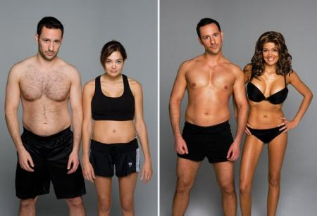
HTML Escaping & Data Validation

Slide 11
HTML Escaping: Motivation
Suppose we run this PHP script:
What if we enter the following in the input field?
<form method="get">
Enter your name: <input type="text" name="name" />
<input type="submit" />
</form>
<?php
if (isset($_GET["name"]))
echo "Hello, " . $_GET["name"];
?>
<script>alert('hi')</script>

Slide 12
HTML Escaping in PHP: htmlspecialchars()
htmlspecialchars(string)
Converts HTML special characters to entities: & " ' < and > become &amp; &quote; &#039; &lt; and &gt;
<form method="get">
Enter your name: <input type="text" name="name" />
<input type="submit" />
</form>
<?php
if (isset($_GET["name"]))
echo "Hello, " . htmlspecialchars($_GET["name"]);
?>

Slide 13
Principles of HTML Escaping
How and when the HTML escape?
HTML escaping should be performed on all data printed in an HTML page, that could contain HTML special chars
Any other behavior is incorrect!
Never escape data when you read it!
Escape the data when you print it in a HTML page
Never store HTML-escaped data in the database!
Never perform double HTML escaping

Slide 14
Example of Correct HTML Escaping
Sample form that can submit HTML special characters:
Example of correct HTML escaping (data only!):
<form method="get">
Name: <input type="text" name="name" value="&lt;br&gt;" />
<input type="submit" />
</form>
<?php
if (isset($_GET["name"]))
echo "Hi, <i>" . htmlspecialchars($_GET["name"] . "</i>");
?>

Slide 15
Example of Incorrect HTML Escaping
Sample form that can submit HTML special characters:
Example of incorrect HTML escaping (don't escape everything):
<form method="get">
Name: <input type="text" name="name" value="&lt;br&gt;" />
<input type="submit" />
</form>
<?php
if (isset($_GET["name"]))
echo htmlspecialchars("Hi, <i>" . $_GET["name"] . "</i>");
?>

Slide 16
Data Normalization
addslashes()
Escapes all special symbols in a string: ', "", \
addcslashes() – escapes given list of characters in a string
quotemeta() – escapes the symbols . \ + * ? [ ^ ] ( $ )
htmlentities() – escapes all HTML entities (£ → &pound;)
echo addslashes("listfiles('C:\')");
// Result: listfiles(\'C:\\\')
echo addcslashes("say('hi')", ';|<>\'"');
// Result: say(\'hi\')

Slide 17
PHP Automatic Escaping Engine
PHP supports the magic_quotes engine
It escapes all necessary characters in the $_GET, $_POST and $_COOKIE array automatically
In versions before 5.2 it is turned on by default
Considered dangerous approach and thus – deprecated
DO NOT USE IT!!!
Developers should handle escaping manually

Slide 18
Validating User Input
Data validation ensures the data we collect is correct
May be performed by filter_var() in PHP
<?php
$ip_a = '127.0.0.1';
$ip_b = '42.42';
if (filter_var($ip_a, FILTER_VALIDATE_IP)) {
echo "This (ip_a) IP address is considered valid.";
}
if (filter_var($ip_b , FILTER_VALIDATE_IP)) {
echo "This (ip_b) IP address is considered valid.";
}
?>

Slide 19
Validating User Input (2)
<form>
<input type="text" name="num" />
<input type="submit" />
</form>
<?php
if (isset($_GET['num'])) {
$num = intval($_GET['num']);
if ($num < 1 || $num > 100) {
echo "Please enter an integer number in range [1..100].";
die;
}
echo "You entered valid number: $num.";
}
?>

Slide 20

HTML Escaping & Data Validation
Live Demo

Slide 21
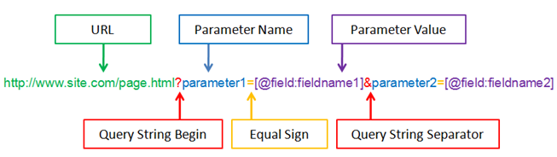
Query String

Slide 22
What is a Query String?
A query string is a part of a URL following a question mark (?)
Commonly used in searches and dynamic pages
Accessed by $_SERVER['QUERY_STRING']
<form>
<input type="text" name="firstName" />
<input type="submit" />
</form>
<?php
echo $_SERVER['QUERY_STRING'];
?>

Slide 23

Creating a Query String
Most common way is by using a form with a GET method
You can also use scripts to add to the query string or simply write your links with the query strings in the href attribute

Slide 24
Query String
Live Demo

Slide 25

Working with Checkboxes

Slide 26
Checkoxes
Checkboxes are created by setting an input with type "checkbox"
<input type="checkbox" name="two-way-ticket" />
A checkbox is only submitted if it's actually checked
if (isset($_GET['two-way-ticket']) ) {
echo "Two-way ticket";
} else {
echo "One-way ticket";
}

Slide 27

Checkboxes
Live Demo

Slide 28

Hidden Fields

Slide 29
Hidden Fields
Created by setting the type of input to hidden
Submit information that is not entered by the user
Not visible to the user, but visible with [F12]
<form method="post">
<input type="text" name="user" />
<input type="submit" />
<?php if (isset($_POST['user'])) { ?>
<input type="hidden" name="hiddenName"
value="<?php echo sha1($_POST['user']) ?>" />
<?php } ?>
</form>

Slide 30
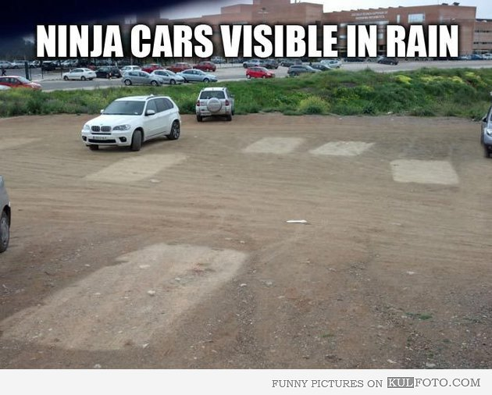
Hidden Fields
Live Demo

Slide 31
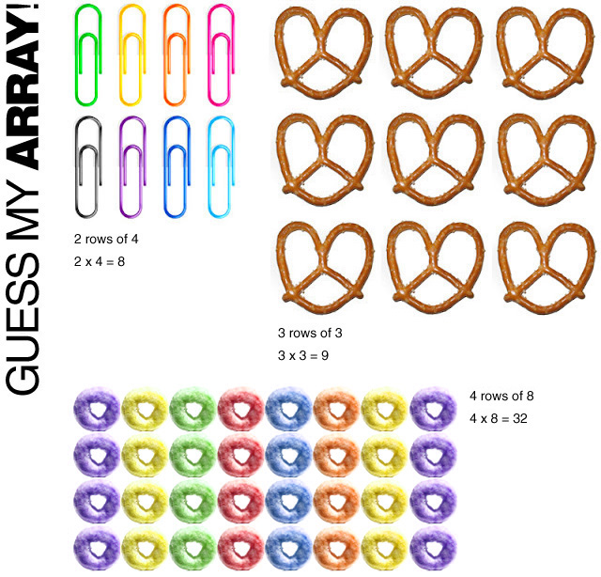
Submitting Arrays

Slide 32
Submitting Arrays
In order for an input to be treated as an array, you must put brackets "[]" in the name attribute:
<form method="post">
<select name="people[]" multiple="multiple">
<option value="Mario">Mario</option>
<option value="Svetlin">Svetlin</option>
<option value="Teodor">Teodor</option>
</select>
<input type="submit" value="submit"/>
</form>

Slide 33

Submitting Arrays (2)
The selected form elements come as an array:
<?php
if (isset($_POST['people'])) {
foreach($_POST['people'] as $person) {
echo htmlspecialchars($person) . '</br>';
}
}
?>

Slide 34

Submitting Arrays
Live Demo

Slide 35
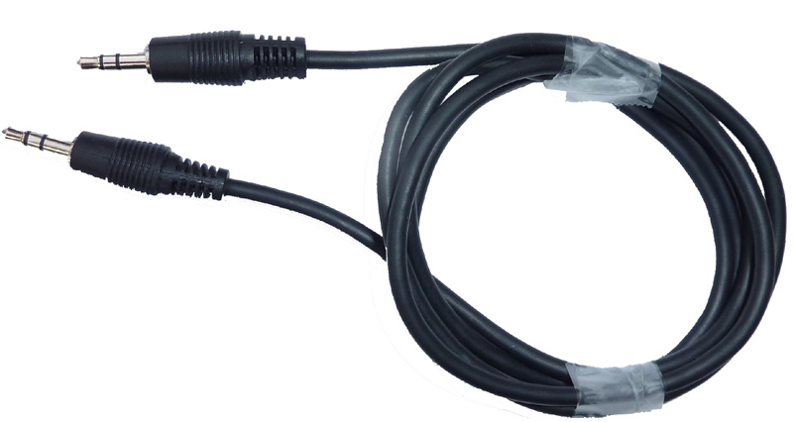
Other Input Types

Slide 36
Other Input Types
Radio, date, datetime, time, number, range, color, …
<form method="post">
Male <input type="radio" name="gender" value="male" /> <br/>
Female <input type="radio" name="gender" value="female" /> <br/>
<input type="submit" value="submit"/>
</form>
<?php
if (isset($_POST['gender'])) {
$selected_radio = $_POST['gender'];
echo "Selected: $selected_radio";
}
?>

Slide 37
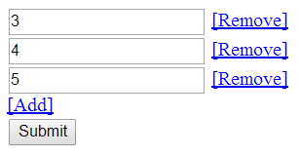
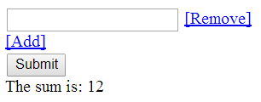
Dynamic Number of Fields
Combining HTML, PHP and JS

Slide 38
Add / Remove Input Fields Dynamically
HTML code
<form method="post">
<div id="parent">
<!-- We shall add inputs here with JavaScript -->
</div>
<script>addInput();</script>
<a href="javascript:addInput()">[Add]</a>
<br />
<input type="submit" value="Submit" />
</form>

Slide 39
Add / Remove Input Fields Dynamically (2)
JS code (1)
<script>
var nextId = 0;
function removeElement(id) {
var inputDiv = document.getElementById(id);
document.getElementById('parent').removeChild(inputDiv);
}
</script>

Slide 40
Add / Remove Input Fields Dynamically (3)
JS code (2)
function addInput() {
nextId++;
var inputDiv = document.createElement("div");
inputDiv.setAttribute("id", "num" + nextId);
inputDiv.innerHTML =
"<input type='text' name='nums[]' /> " +
"<a href=\"javascript:removeElement('num" + nextId +
"')\">[Remove]</a>" + "<br/>";
document.getElementById('parent').appendChild(inputDiv);
}

Slide 41
Add / Remove Input Fields Dynamically(4)
PHP code
<?php
if (isset($_POST['nums'])) {
$nums = $_POST['nums'];
$sum = 0;
foreach ($nums as $item) {
$sum += $item;
}
echo "The sum is: $sum";
}
?>

Slide 42
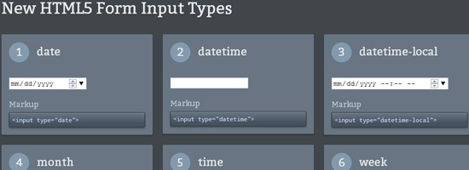
Other Input Types
Live Demo

Slide 43



Redirecting the Browser

Slide 44
Redirecting the Browser
Done by using the HTTP "Location" header
This sends HTTP 302 "Found" in the HTTP response status code
Tells the browser to open a new URL
header('Location: http://softuni.bg');

Slide 45

Redirecting the Browser
Live Demo

Slide 46
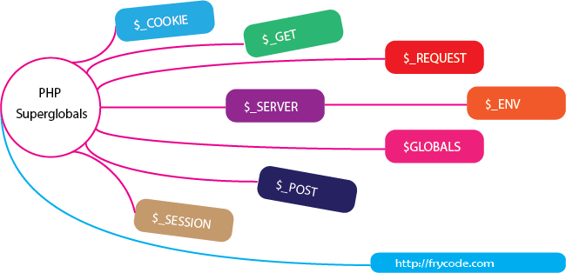
Other Superglobals in PHP

Slide 47
$GLOBALS
Access the global variables from anywhere in the PHP script
<?php
$x = 75;
$y = 25;
function addition() {
$GLOBALS['z'] = $GLOBALS['x'] + $GLOBALS['y'];
}
addition();
echo $z; //returns 100
?>

Slide 48

$_SERVER, $_REQUEST
$_SERVER – holds information about headers, paths, and script locations
$_REQUEST – an associative array that contains the $_GET, $_POST and $_COOKIE
<?php print_r($_SERVER); ?>
<?php print_r($_REQUEST); ?>

Slide 49
$_SESSION
Sessions preserve data between different HTTP requests
Implemented through cookies
$_SESSION is an global array holding the session variables
After session_start() it is stored on the HDD
<?php
session_start();
if (!isset($_SESSION['count'])) {
$_SESSION['count'] = 0;
} else {
$_SESSION['count']++;
}

Slide 50
$_COOKIE
What is a cookie?
A piece of data that the server embeds on the user's computer
Has name, value and timeout
Reading the cookies sent by the browser
$_COOKIE[]
Send cookies to be stored in the client's browser
setcookie(name, value, expiration)

Slide 51
Cookies – Demo
<html>
<body>
<?php
if (isset($_COOKIE["user"]))
echo "Welcome " . $_COOKIE["user"] . "!<br>";
else
echo "Welcome guest!<br>";
setcookie("user", "Nakov", time() + 10); // expires in 10 seconds
?>
</body>
</html>

Slide 52
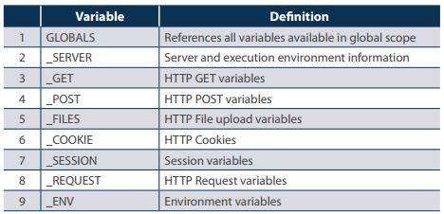
Other Superglobals
Live Demo

Slide 53

Summary
HTTP request methods – GET, POST, etc.
Normalization and validation
Working with query strings
You can easily combine PHP and HTML
You can get input as array
Special input fields – checkboxes, hidden fields
Using PHP Superglobals: $GLOBALS, $_SERVER, $_REQUEST, $_SESSION, $_COOKIE

Slide 54
Working with Forms
https://softuni.bg/trainings/coursesinstances/details/5

Slide 55
License
This course (slides, examples, demos, videos, homework, etc.) is licensed under the "Creative Commons Attribution-NonCommercial-ShareAlike 4.0 International" license
Attribution: this work may contain portions from
"PHP Manual" by The PHP Group under CC-BY license
"PHP and MySQL Web Development" course by Telerik Academy under CC-BY-NC-SA license

Slide 56





Free Trainings @ Software University
Software University Foundation – softuni.org
Software University – High-Quality Education, Profession and Job for Software Developers
softuni.bg
Software University @ Facebook
facebook.com/SoftwareUniversity
Software University @ YouTube
youtube.com/SoftwareUniversity
Software University Forums – forum.softuni.bg

